Slide 1



CSA1216-COMPUTER ARCHITECTURE
Interrupt-Driven Emergency Response Management System with Bus and Memory Performance Analysis
PRESENTED BY:
N.Nesarajan (192511386)
J.Yukesh kumar(192524464)
GUIDED BY:
Dr. Jerin Simla

Slide 2
INTRODUCTION
An interrupt is a signal that tells the CPU to stop its current
work and handle an important task.
In a hospital, many emergency alerts can happen at the same time.
This project shows how a computer processes these emergency
alerts using interrupts and analyzes CPU, bus, and memory performance.

Slide 3
PROBLEM STATEMENT
In hospitals, many emergency alerts may occur at the same time.
Examples:
Heart Attack
Fire Alarm
Low Oxygen Level
Nurse Emergency Call
It becomes difficult to manage all these alerts together.
This project simulates how the CPU handles these emergency events
using interrupt processing.

Slide 4
OBJECTIVES
Generate emergency events.
Process events using CPU interrupts.
Give higher priority to critical emergencies.
Simulate CPU processing.
Analyze bus usage.
Analyze memory usage.
Display system performance.

Slide 5
EXISTING SYSTEM
Existing System
Hospital devices generate emergency alerts.
Alerts are displayed on a monitoring screen.
Doctors and nurses respond to the alerts.
Limitations
No interrupt simulation.
No CPU performance analysis.
No bus usage analysis.
No memory usage analysis.

Slide 6
PROPOSED SYSTEM
Proposed System
Our system treats every emergency as a CPU interrupt.
Working Process
Generate emergency events.
Store events in an interrupt queue.
Assign priorities.
CPU processes interrupts.
Simulate bus and memory usage.
Display performance results.
Advantages
Easy to understand interrupt processing.
Shows CPU performance.
Shows bus and memory usage.
Interactive dashboard.

Slide 7
Module 1 – Emergency Interrupt Management
Functions
Create emergency events.
Assign priority levels.
Store events in the interrupt queue.
Process interrupts.
Show completed events.
Output
Interrupt Queue
Current Interrupt
Completed Interrupts
Execution Log.

Slide 8
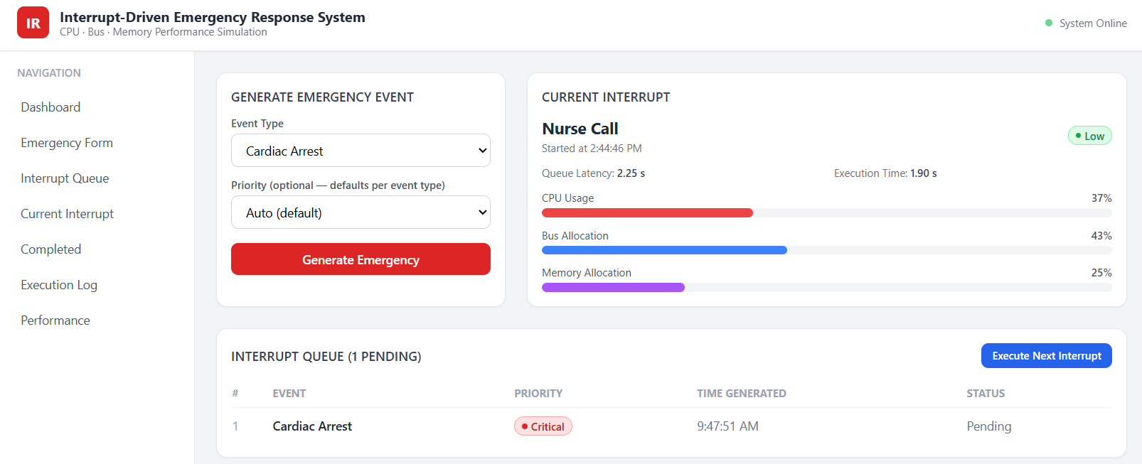
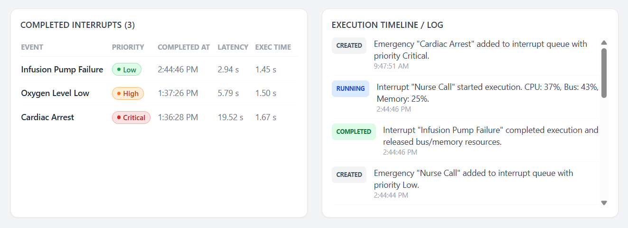
Module 1 – Emergency Interrupt Management
IMPLEMENTATION

Slide 9
Module 2 – Bus and Memory Performance Analysis
Functions
Simulate bus access.
Allocate memory.
Release memory.
Calculate CPU usage.
Display performance charts.
Output
CPU Usage
Bus Usage
Memory Usage
Performance Report

Slide 10
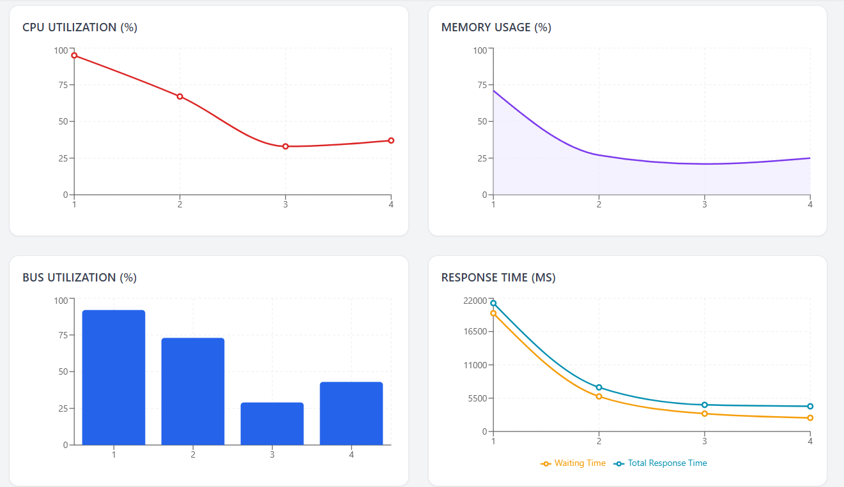
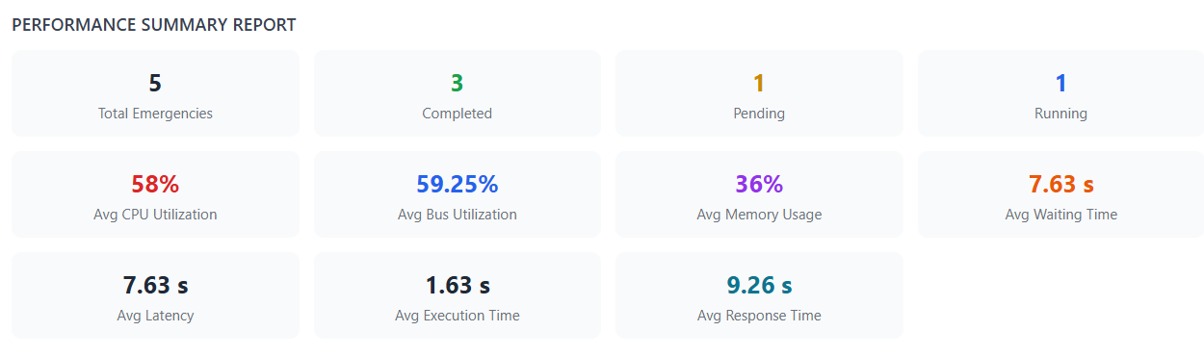
Module 2 – Bus and Memory Performance Analysis
IMPLEMENTATION

Slide 11
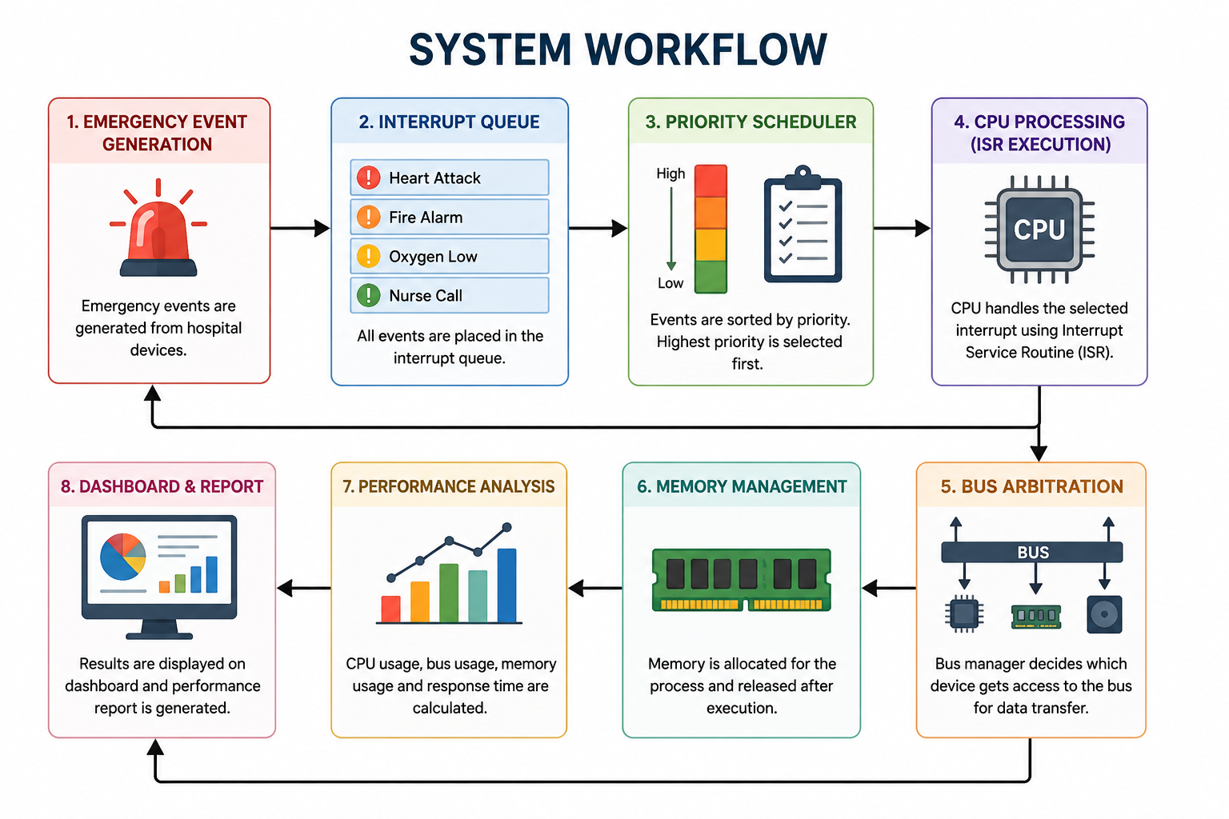
SYSTEM WORKFLOW

Slide 12
EXPECTED OUTPUT
Emergency events are created.
Interrupts are processed based on priority.
CPU processes one interrupt at a time.
Bus usage is displayed.
Memory usage is displayed.
Performance charts are generated.
Performance report is shown.

Slide 13
FUTURE SCOPE
Connect the system with real hospital IoT devices.
Use AI to automatically prioritize emergency alerts.
Support multiple hospitals in one monitoring system.
Add a mobile application for doctors and nurses.
Store emergency records in the cloud for easy access.
Improve bus and memory analysis using real hardware.
Generate detailed performance reports automatically.
Extend the system to other fields such as factories, airports, and smart cities.

Slide 14
REFERENCES
Ghoni, R., & Ibrahim, T. (2021). Integration of Emergency Response Management System with Internet of Things. Journal of Physics: Conference Series, 1874, 012074. DOI: 10.1088/1742-6596/1874/1/012074. — Useful for connecting IoT with emergency monitoring, real-time analytics, warning systems, and emergency management.
Yang, L., Yang, S. H., & Plotnick, L. (2013). How the Internet of Things Technology Enhances Emergency Response Operations. Technological Forecasting and Social Change, 80(9), 1854–1867. DOI: 10.1016/j.techfore.2012.07.011. — Good foundational reference for IoT-enabled emergency response operations.
Pushpalatha, N., et al. (2025). Intelligent IoT and AI-Driven Ambulance Dispatch and Traffic Preemption System. ICCETM 2025. DOI: 10.1109/ICCETM66557.2025.11557822. — Particularly relevant if your system includes ambulance dispatch, real-time communication, and traffic-signal preemption.
Devi, V., et al. (2026). A Real-Time Adaptive AI Based Traffic Management Framework for Ambulance Priority. ICPCSN 2026. DOI: 10.1109/ICPCSN68523.2026.11543612. — Useful for discussing real-time emergency prioritization and reducing ambulance response delays.
Prasad, A. S., et al. (2026). IoT-Based Emergency Vehicle Priority Traffic Control Using Realtime Signal Adjustment. IEEE GSEACT 2026. DOI: 10.1109/GSEACT68539.2026.11619940. — Strong recent reference for IoT, emergency vehicles, real-time control, and embedded controllers.
Bruno, J., et al. Interrupt Latency. Proceedings of the Workshop on Embedded Systems, USENIX. — Very useful for explaining interrupt latency, interrupt-disabled periods, interrupt handling, and real-time responsiveness.
Microchip. (2026). Interrupt Performance and Interrupt Latency. — Useful technical reference for defining interrupt latency as the time between detecting an interrupt and execution of the first ISR instruction.
Microchip. Interrupt Latency — CPU/Bus/Memory Performance. — Especially relevant to your exact title, because it explains how arbitration time, instruction execution, vector memory access, and program-memory access contribute to interrupt latency.
Sloss, A. N., Symes, D., & Wright, C. ARM System Developer's Guide: Designing and Optimizing System Software. — Useful background reference for interrupt handling, interrupt prioritization, nested interrupts, and embedded-system performance. The interrupt-latency discussion is summarized in the technical literature.
Walls, C. (2012). Measuring Interrupt Latency. Siemens Embedded Software. — Useful for explaining how interrupt latency should be measured and why different systems can report different latency measurements.

Slide 15
CONCLUSION
This project demonstrates how Computer Architecture concepts such as
interrupts, CPU processing, bus communication, and memory management
can be applied to a hospital emergency scenario.
It provides an easy way to understand how interrupt-driven systems work and
helps analyze overall system performance.

Slide 16
THANK YOU

